Slide 1
VECTO Trailer Tool

Slide 2
Content
References to information in Technical Annexes of the Trailer Regulation
VECTO Trailer Tool
  Software package
  JobFiles GUI
  Options GUI
  Background worker
  How to create or edit trailer job
  Result files
Generation of input XML for a certified aero device
Overview content of VECTO Trailer Tool Masterexcel

Slide 3
References to information in Technical Annexes of the Trailer Regulation
Annex Number | Title | Further Explanation
Annex I | Classification of vehicles in vehicle groups | Required definitions and classification system for trailers covered by the Regulation
Annex II | Requirements and processes for the operation of the simulation tool | Requirements for the process to be able to determine the official values within the framework of trailer regulation by means of the VECTO Trailer Tool
Annex III | Input information about the characteristic of the vehicle | Definitions and precise description of the input parameters into the tool and how to determine them
Annex IV | Template of the Manufacturer‘s Records file and of the Customer Information file | Definition of content and structure of the Manufacturer‘s Records file (MRF) and the Customer Information file (CIF)
Annex V | Vehicle‘s air drag data | Defines the procedures how the features of aerodynamic devices shall be determined, either via virtual testing using CFD or by applying standard reduction rates for aerodyanmic devices fulfilling certain minimum properties

Slide 4

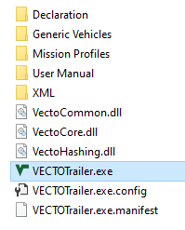
VECTO Trailer Tool – Software package
Content of VECTO Trailer Tool package as downloaded from JRC server
can be copied to any place on a PC/server*
Hard coded data via *.csv files for information purposes
Example files for trailers and tyres and XML files of the generic towing vehicles and certified aerodynamic devices
Example XML files and XSD files
Executable, just double-click to start
* Snapshot shows only a reduced set of data included in the downloadable package

Slide 5
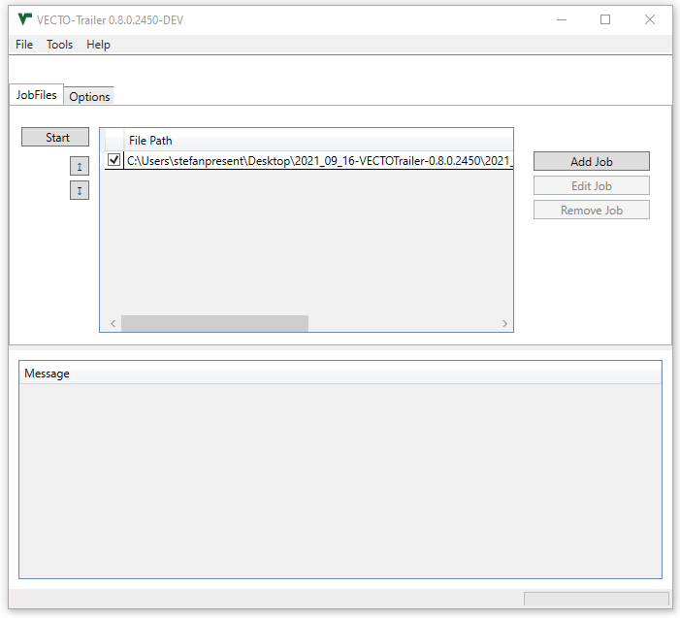
VECTO Trailer Tool – JobFiles GUI
Toolbar with common controls like “add new Job”
Switch between “Job Files” and “Options” tab
Start button to simulate active Jobs
Buttons to handle Job files
Add new Jobs
Edit existing Jobs from Job window
Delete Jobs from Job window
Job window that shows all loaded Job files
Message window showing the calculation status

Slide 6
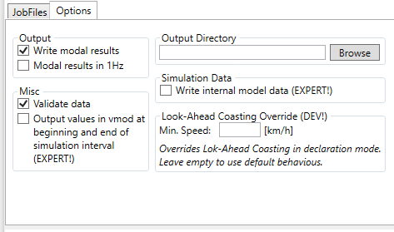
VECTO Trailer Tool – Options GUI
At first program start it is recommended to check the main tool settings and define the output directory
The settings displayed below are the default, recommended settings
Settings only affect the handling of input data or results, but do not influence the official results.
Output directory
Modal results in 1 Hz:
If selected, the modal results (.vmod file) will be converted into 1Hz after the simulation. This may add certain artefacts in the resulting modal results file.
Browse button
Enables or disables internal checks if the model parameters are within a reasonable range.
Checkbox to create JSON file with input/simulation data of simulated Jobs
If this option is enabled, the .vmod file will contain two entries for every simulation interval, one at the beginning and one at the end of the simulation interval.

Slide 7
VECTO Trailer Tool - Background worker
Enables a simple autonomisation of simulation runs
The background worker periodically searches a directory specified by the user for new input XMLs
If a new file is available, a calculation is automatically started in the background
After completion, the result files are stored in another directory to be specified by the user

Slide 8
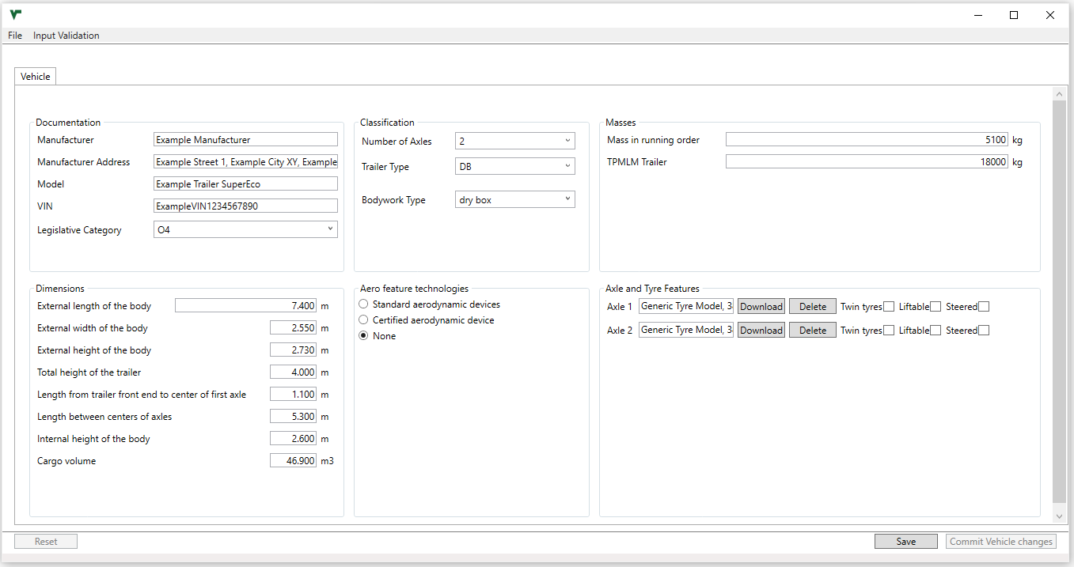
VECTO Trailer Tool – Create or edit trailer job (1/6)
Open window via
  “Edit Job” or
  Right click on Job window → “Create Trailer Job”
Define trailer specifications
Define Aero feature technologies
Define Axle and Tyre features

Slide 9
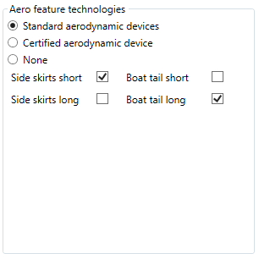
VECTO Trailer Tool – Create or edit trailer job (2/6)
Define Aero feature technologies
Choose this if the trailer is equipped with standard aerodynamic device(s)
Reduction of Standard aerodynamic devices can be found in:
Checkbox to declare applicable standard aerodynamic device(s)
Note that not all combinations are valid → see also:
Masterexcel
  sheet „Combination Add-ons“
trailer_combination_addon.csv in the Declaration folder,
Task 2 report
Masterexcel
  sheet „Combination Add-ons“ or „Specific Trailer“ column X to BG
specific_trailer.csv in the Declaration folder,
Task 2 report

Slide 10
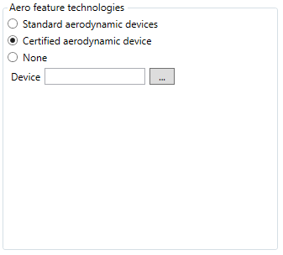
VECTO Trailer Tool – Create or edit trailer job (3/6)
Define Aero feature technologies
Choose this if the trailer is equipped with a certified aerodynamic device
Brows button to search for the XML file of the certified aerodynamic device

Slide 11
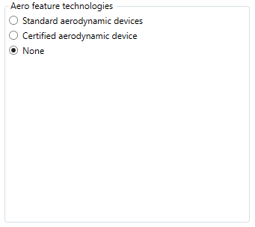
VECTO Trailer Tool – Create or edit trailer job (4/6)
Define Aero feature technologies
Choose this if the trailer is equipped with no aerodynamic device(s)

Slide 12
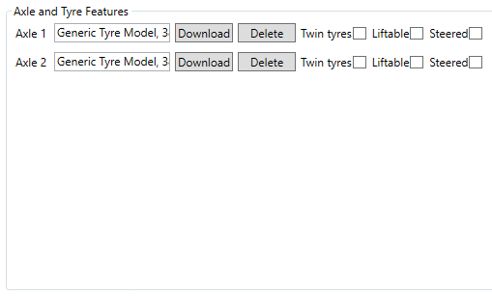
VECTO Trailer Tool – Create or edit trailer job (5/6)
Define Axle and Tyre features
Checkbox to declare applicable tyre/axle features
Effect of liftable/steered axles can be found in:
Masterexcel
  sheet „Specific Trailer“ column E to P
specific_trailer.csv in the Declaration folder,
or the Task 2 report
Download
Brows button to search for tyre XMLs
Delete
Delete loaded or pre defined tyre XML

Slide 13
VECTO Trailer Tool – Create or edit trailer job (6/6)
Save Job file
Press “Start” in Job file editor to start simulation of active Jobs
When the Job-file is saved, a message window will pop up if any errors are detected in the inputs

Slide 14
Generation of input XML for a certified aero device (1/X)
The XML needs to be created by the supplier within a separate certification process
A template of the XML is located in the downloadable VECTO Trailer Tool package in the “Generic vehicles” folder
The XSD file is located in the downloadable VECTO Trailer Tool package in the “XML” folder

Slide 15
Generation of input XML for a certified aero device (2/X)
Snapshot XML vor hashing
Erklären wie hashing funktioniert + Snapshot hashing tool
Snapshot fertiges XML

Slide 16
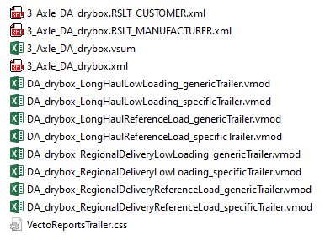
VECTO Trailer Tool – Result files (1/2)
Outputs created by the VECTO Trailer Tool including the corresponding Job file
CIF/ Customer Information File
MRF/ Manufacturers Records File
vsum File
Job-File
vmod File per mission and payload combination for the reference and specific trailer

Slide 17
VECTO Trailer Tool – Results (2/2)
Result file | Description
Manufacturer‘s Records File (MRF) | Output for regulatory purpose in XML format ref to definition in the regulation? ‘manufacturer’s records file’ means a file produced by the simulation tool which contains manufacturer related information, a documentation of the input data and input information to the simulation tool and the results for CO2 emissions and fuel consumption;
Customer Information file (CIF) | Output for regulatory purpose in XML format ref to definition in the regulation? ‘customer information file’ means a file produced by the simulation tool which contains a defined set of vehicle related information and the results for CO2 emissions and fuel consumption as defined in Part II of Annex IV;
Pdf-output | Formatted printable output of the customer information file
vsum-file* | Output for engineering purposes in csv-format. Single line of results per each simulated combination of trailer, mission profile and payload with aggregate and or average values
vmod-file* | Output for engineering purposes in csv-format. Single file per each simulated combination of trailer, mission profile and payload with time-resolved simulation results from the VECTO core.
* A documentation of the results contained in the vsum and vmod files can be found in the help file for the VECTO calculation core (help.html), which is also included in the VECTO Trailer Tool release.

Slide 18
Overview content of Masterexcel (1/4)
The VECTO Trailer Tool Masterexcel is an integral part of the tool documentation and fulfils the following functions:
Documentation of the classification matrix used internally in the tool, which is more detailed than the classification according to Annex I.
Documentation of all generic data stored in the tool (e.g. mission profile and payload allocation, specifications of reference trailers, standard values for reduction rates of aerodynamic devices etc.)
Documentation of the formulas for calculating the air drag for the various combinations of generic towing vehicles and trailers
Documentation of bonus factors for liftable and steered axles
The content of the individual sheets is described in overview on the next slides.
In the context of a normal application of the tool, it is not necessary to engage with the Masterexcel.

Slide 19
Overview content of Masterexcel (2/4)
Excel sheet | Description
Classification | General information stored in the tool for each trailer configuration Vehicle group acc. to Annex 1 Information on the allocated generic towing vehicle Mission allocation + weighting for aggregated results Payload and axle weight shares per mission
Generic CAD vehicle | Main dimensions and air drag values of the generic CAD models used as a starting point to calculate the air drag of trailers with different dimensions (could be the reference- or the specific trailer)
Reference Trailer | Information on the reference trailers for each trailer configuration Curb mass and cargo volume Tyre specifications Main external dimensions to calculate the air drag Indication on which aero corrections are applied to which trailer configuration „1“ means aero correction is applied „0“ means aero correction is not applied

Slide 20
Overview content of Masterexcel (3/4)
Excel sheet | Description
... | ...
Specific trailer | Information on technologies that may be present on a specific trailer Bonus factors for liftable and steered axles depending on trailer configuration, mission and payload These factors are to be understood as reduction factors on overall fuel consumption / CO₂ Indication on which aero corrections are applied to which trailer configuration „1“ means aero correction is applied „0" means aero correction is not applied The individual aero correction formulas can be viewed in the “Reference/Specific Trailer Aero" sheet and are documented in detail in Task 2 report section 2.4.5. Aero reduction values for standard aerodynamic devices acc. to sheet „Combination Add-ons DX*“
Standard Trailer | Information on the standard trailers also used in Regulation EU 2017/2400 to calculate the reference factors
*DX... Placeholder depending on trailer type
DA... Semi Trailer
DB... Drawbar Trailer
DC... Centre axle Trailer

Slide 21
Overview content of Masterexcel (4/4)
Excel sheet | Description
... | ...
Reference (Specific) Trailer Aero | Main dimensions and air drag values of the generic CAD models used as a starting point to calulate the air drag of trailers with different dimensions (Reference/Specific trailer) Step by step calculation process on how to apply the individual aero corrections to get the final air drag values for a reference/specific trailer In the columns AN to AX, the aero-relevant data can be entered for the individual trailer groups. The results for CdxA(0) as well as the polynomial coefficients of the polar can then be found in the columns DT and EB to ED.
Combination Add-ons DX* | Air drag reduction in % for the specific combination of standard aerodynamic devices (the reduction values can also be found in the sheet „Specific Trailer“
Efficiency Ratios - DA | Example on how the individual and weighted efficiency ratios are calculated based on a DA trailer
*DX... Placeholder depending on trailer type
DA... Semi Trailer
DB... Drawbar Trailer
DC... Centre axle Traielr

